Slide 1

To be your first choice for caring, comprehensive and well-coordinated behavioral health services.

Slide 2
Offices Located:
Hamilton 1490 University Boulevard
Lebanon 212 Cook Road
Middletown 1131 Manchester Avenue
Oxford 10 N. Locust
513-896-7887

Slide 3
Child & Family Services 0-18
Program | Team Structure | Frequency | Duration | Add on Services
WINGS (Intensive Home-Based Family Therapy) | 1 Therapist 1 Skill builder | 3x/week | 4-5 months | Psychiatric Services
Early Childhood | 1 Therapist 1 Skill builder | 3x/week | 4-5 months
Home Based Therapy | 1 Therapist | 1x/week | Once treatment goal is met | Psychiatric Services Health Now
Health Now (Integrated Care Management) | 1 Integrated Care Manager | Need-based (1x/month minimum) | Once treatment goal is met | Psychiatric Services BBH therapy Therapy with outside agencies

Slide 4
Intensive Home-Based Services
WINGS
  Create family system-based goal
  Work to stabilize family unit
  Assist with whole family progress
  Teach/practice skills needed to meet goal
  Focus on mindfulness, distress tolerance, interpersonal effectiveness and learning coping strategies
Early Childhood
  Serves children 0-8
  Focus on Early Childhood Development
  Emphasis on parent-child interactions
  Teach/practice skills related to attachment and connection

Slide 5
Additional Home-Based Services
Home Based Therapy
  Individual therapy for children 3-18 years of age
  Includes the family system in order to meet goals
  Trauma Informed Therapy when appropriate
  Ability to occur in the home, school or community-based setting
Health Now Kids
  Combination of skill building and case management
  Ability to assist with
    Coordinating with primary care, dental and vision providers
    Benefit management
    Obtaining social security, Medicaid and disability benefits
    School Advocacy
    IEP, 504
    Linking to Wraparound Services

Slide 6
Program Examples
WINGS
15 yo released from Juvenile Detention, family involvement with Children’s Services. History of school suspensions, and truancy. MRSS called within 24 hrs of release from JDC.
Early Childhood
6-month-old infant recently removed from birth mother by and placed with foster parent.
History of trauma, neglect and insecure attachment.
Family would benefit from trauma education
Home Based
12-year-old in school-based therapy with another agency
School reports no behaviors
Parent reports defiance and outbursts in the home
Parent reports some skills already possessed to assist client
Health Now
5-year-old
No primary care physician, dental or vision doctors
Family history of unstable housing
Family lacks community resources
Child has social skills deficits

Slide 7
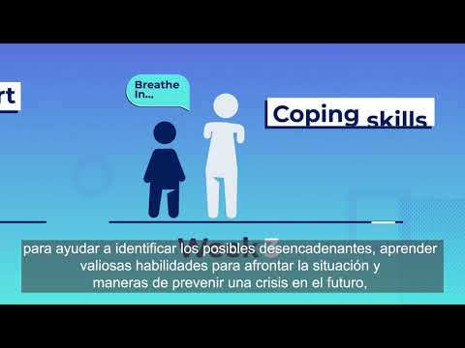
Mobile Response & Stabilization Services Video
Warren & Clinton County Hotline: 877-695-6333(NEED)
Direct Number M-F 8:00 am to 5:00 pm 513-785-2160

Slide 8
Community Based Services for Adults
Health Now Integrated Care Management
Improves health and wellness by focusing on all aspects of people’s lives; mind and body. We partner with clients to reach and support healthy lifestyle choices and goals through teaching and practicing skills.
We additionally will collaborate and coordinate services across providers. Services include: Consultation with external providers to assist with client needs, service planning and care coordination. Referral and linkage with resources to avoid higher levels of care. Interventions using evidence-based techniques. Identification of treatment strategies and options. Restoration of social skills and daily functioning. Crisis prevention and amelioration.
Uplift Senior Services - Home based therapy for older adults experiencing mild depression and/or anxiety.

Slide 9
Outpatient Counseling​
​Open Access – walk into any location between 9-3pm to begin services​. We provide services for all ages.
Psychotherapy/Counseling to partner in achieving goals.
​
​
Vocational Services​
WorkPlace Associates offers a broad range of vocational supports that develop and match a person’s strengths and skills with the best possible community employment opportunity.​
​
Vocational preference and readiness evaluations​
Vocational case management​
Job development and job placement​
On site job coaching​
Job retention support​
​
WorkPlace Associates assists first time job seekers, as well as, those with disabilities who are re-entering the workforce.​
​

Slide 10
Thank you for watching our presentation
To make a referral:
Dedicated FAX line: 513-261-6959
Dedicated email: referrals@bbhs.org
Our website: www.BBHS.org
Look for the green box "MAKE A REFERRAL" at the top of the page.
For more general information:
Phone: 513-896-7887
Facebook: https://www.facebook.com/ButlerBehavioralHealthServices/

